Slide 1




EMPLOYEE DATA ANALYSIS
By Khushboo Pal

Slide 2
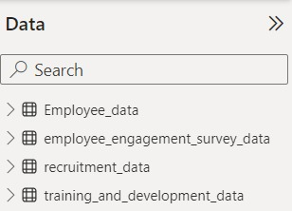
INTRODUCTION
DATA CONSISTS OF
4 Excel Files as-
The data consists of 45 attributes as Employee details, Training, Performance, Employee engagement etc.
TASK ASSIGNED
The task involves effectively managing a dataset and generating meaningful insights using Excel as the tool of choice.
The challenge is to handle dataset and generate insightful output.
Transform raw data into insightful visualizations and reports for informed decision-making.

Slide 3
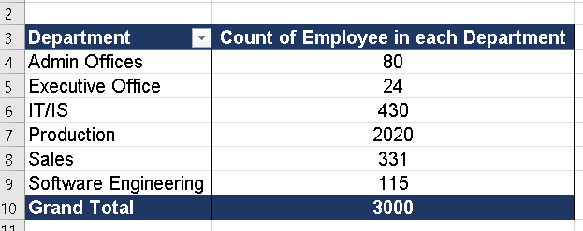
Can you create a pivot table to summarize the total number of employees in each department?

Slide 4
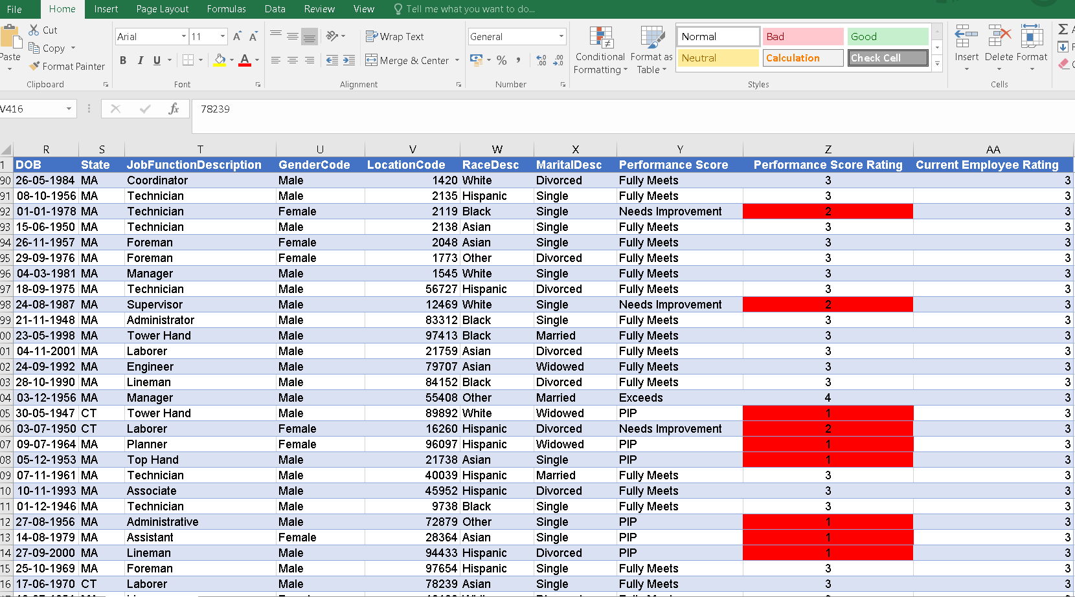
Apply conditional formatting to highlight employees with a "Performance Score" below 3 in red.
There are 2548 Employees who have Performance Score below 3.

Slide 5
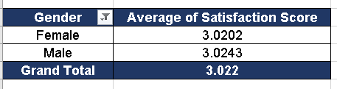
Calculate the average "Satisfaction Score" for male and female employees separately using a pivot table.

Slide 6
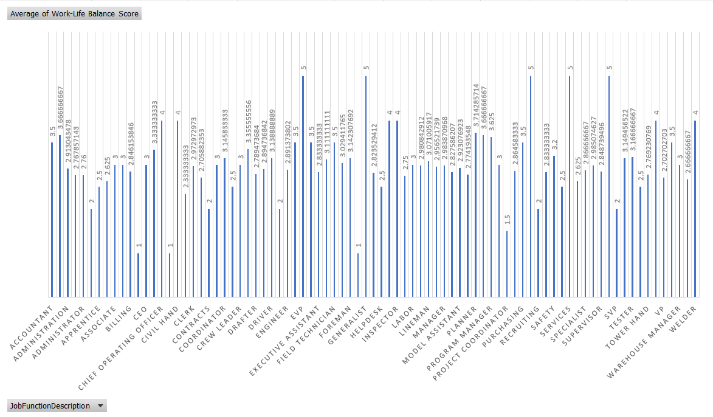
Create a chart to visualize the distribution of "Work-Life Balance Score" for different job functions.

Slide 7
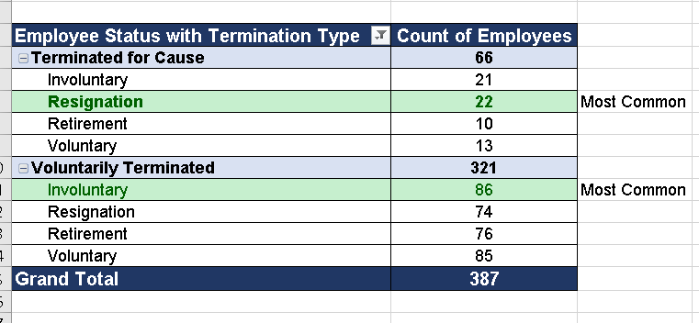
Filter the data to display only terminated employees and find out the most common "Termination Type."

Slide 8
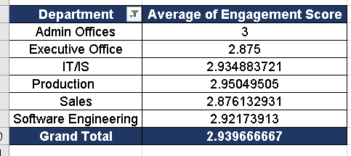
Calculate the average "Engagement Score" for each department using a pivot table.

Slide 9
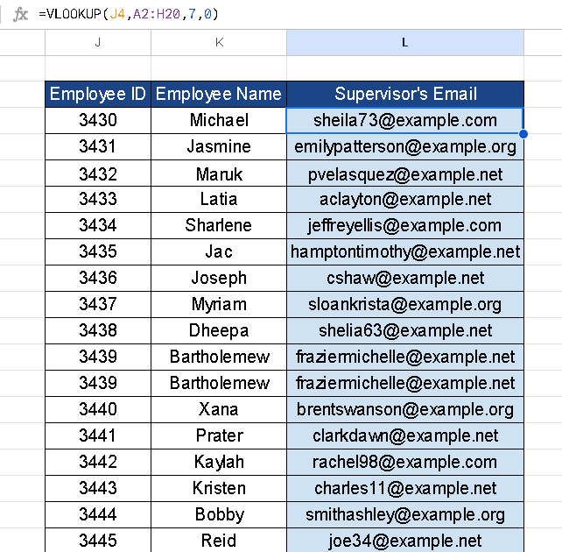
Use VLOOKUP to find the supervisor's email address for a specific employee.

Slide 10
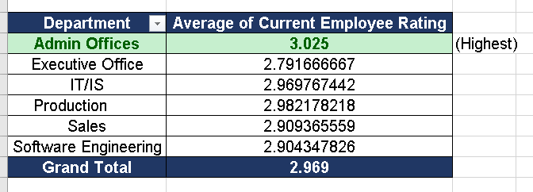
Can you identify the department with the highest average "Employee Rating?"

Slide 11
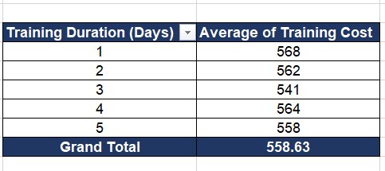
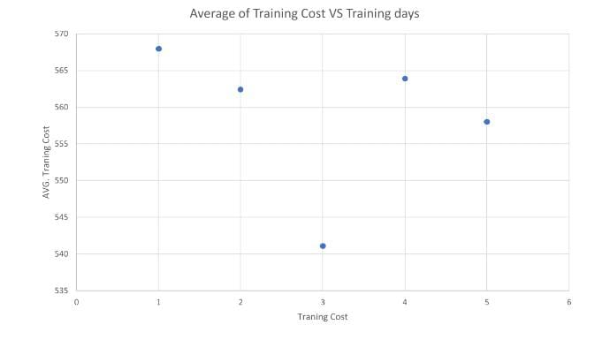
Create a scatter plot to explore the relationship between "Training Duration (Days)" and "Training Cost."

Slide 12
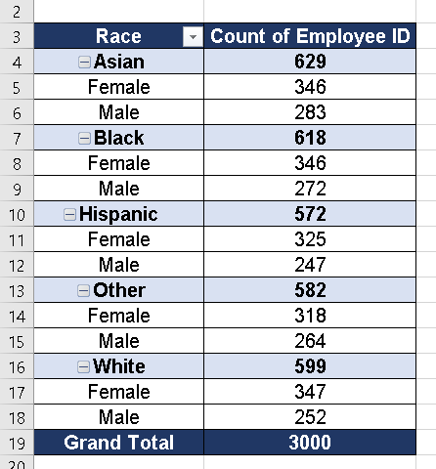
Build a pivot table that shows the count of employees by "Race Desc" and "Gender Code."

Slide 13
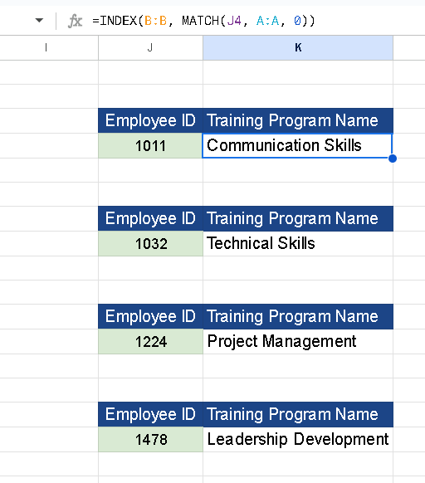
Use INDEX and MATCH functions to find the "Training Program Name" for an employee with a specific ID.

Slide 14
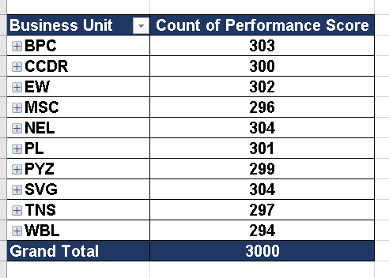
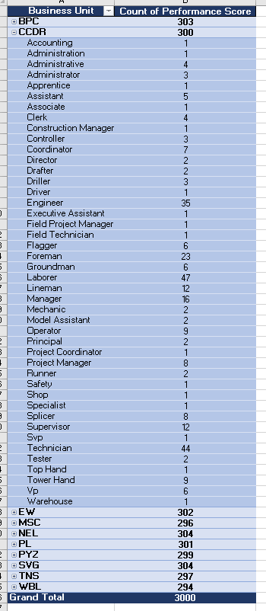
Create a multi-level pivot table to analyze the "Performance Score" by "Business Unit" & "Job Function Description”.

Slide 15
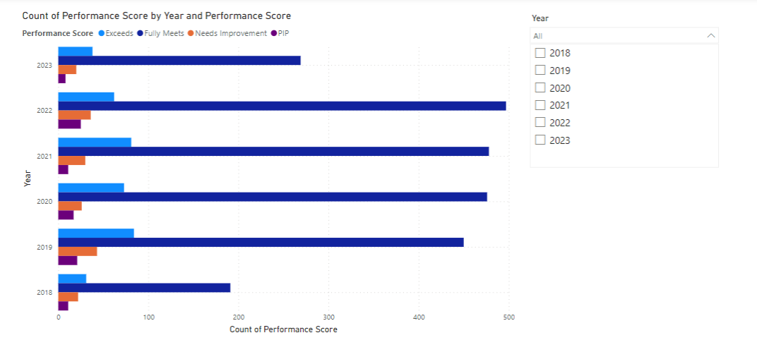
Design a dynamic chart that allows users to select and visualize the performance of any employee over time.

Slide 16
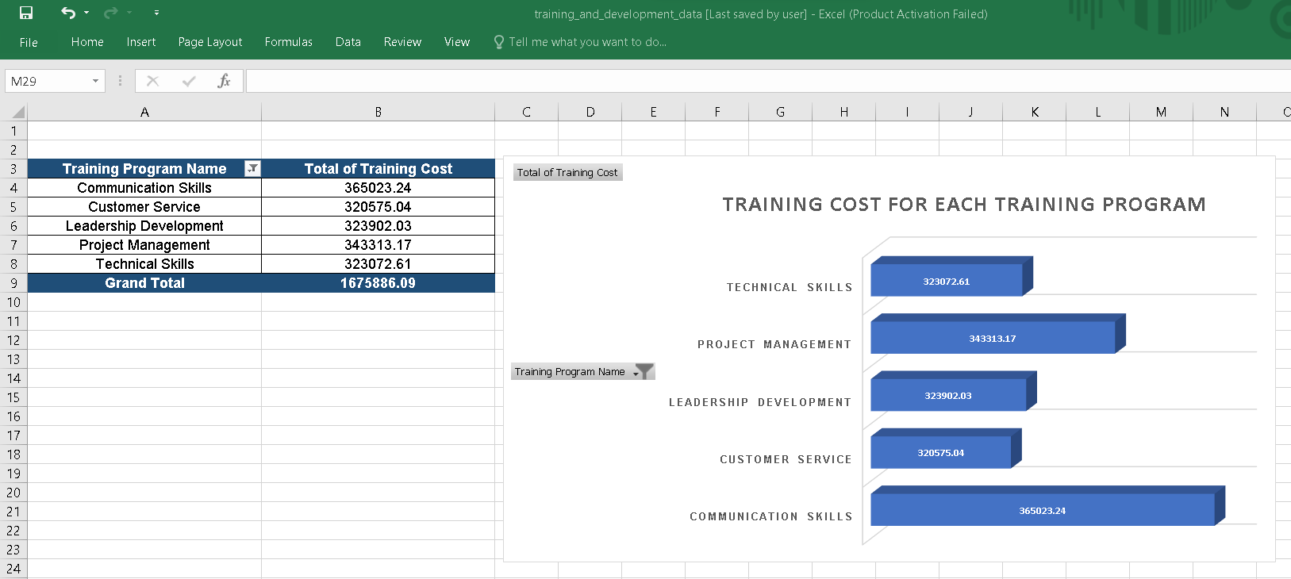
Calculate the total training cost for each "Training Program Name" and display it in a bar chart.

Slide 17
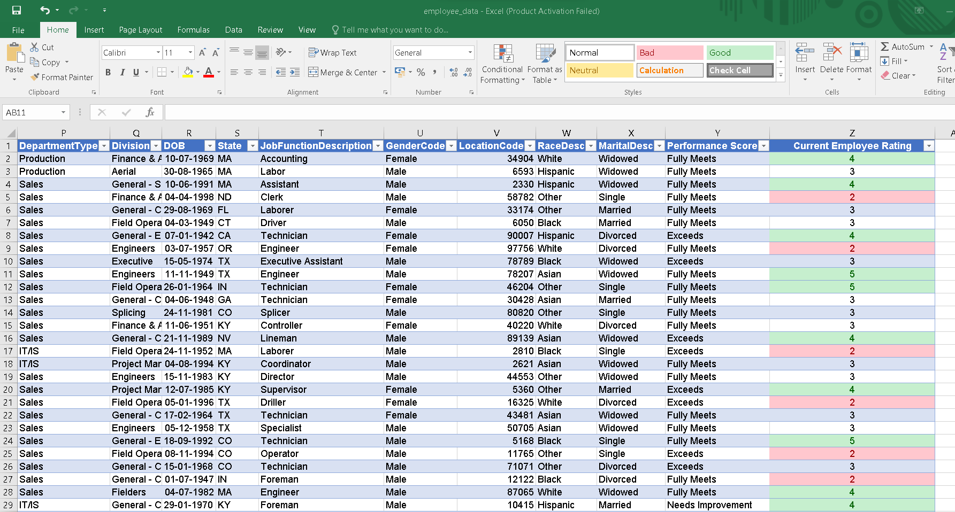
Apply advanced conditional formatting to highlight the top 10% and bottom 10% of employees based on "Current Employee Rating."

Slide 18
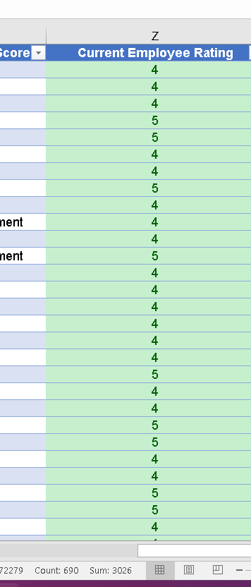
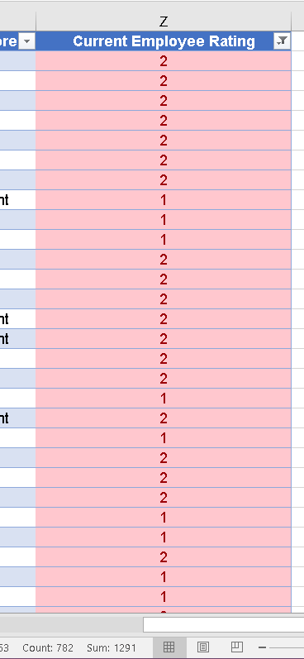
Top 10%=
689
Bottom 10%= 781

Slide 19
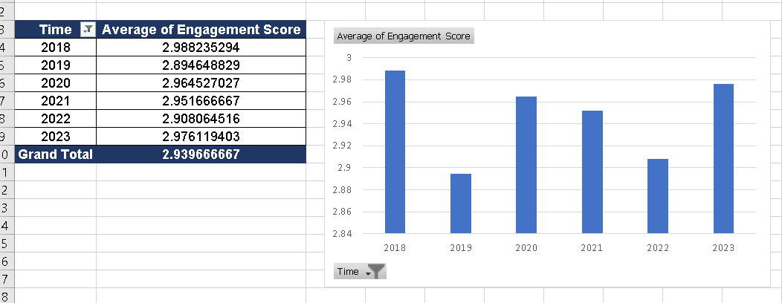
Use a calculated field in a pivot table to determine the average "Engagement Score" per year.

Slide 20
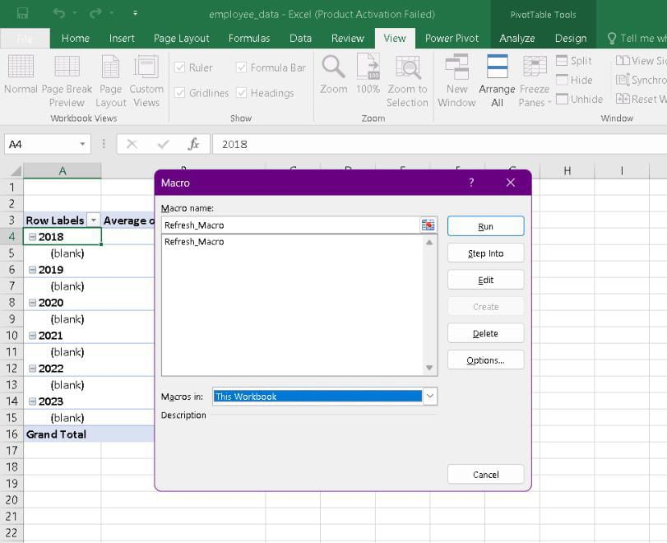
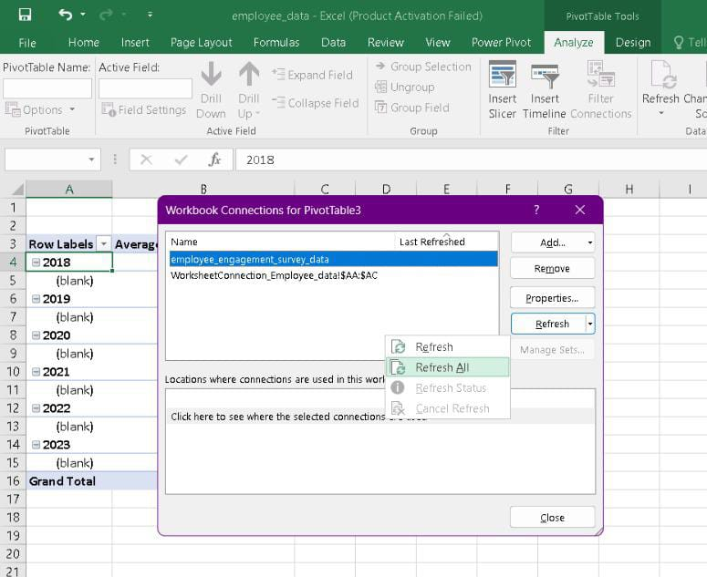
Can you build a macro that automates the process of updating and refreshing all pivot tables in the workbook?
Open your Excel workbook.
Navigate to the "Data" tab on the ribbon.
Look for the "Refresh All" button in the "Connections" group. Click on it.
In Excel 2010 and 2013, you might find it under the "Refresh" option.
In Excel 2016 and later versions, it's usually in the "Connections" group.
Clicking "Refresh All" will update all connections and refresh all Pivot Tables in the workbook.

Slide 21
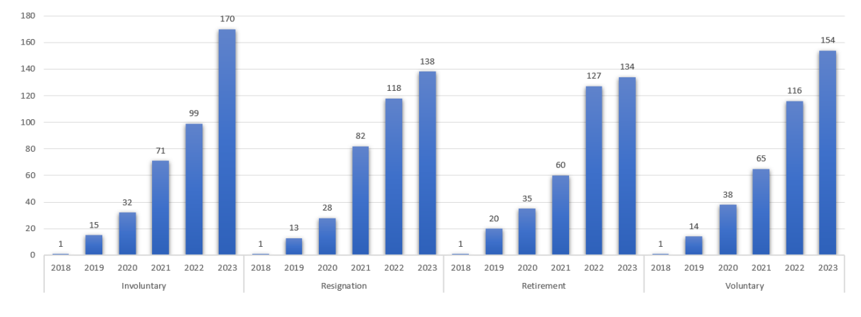
Create a histogram to understand the distribution of "Exit Date" for terminated employees.

Slide 22
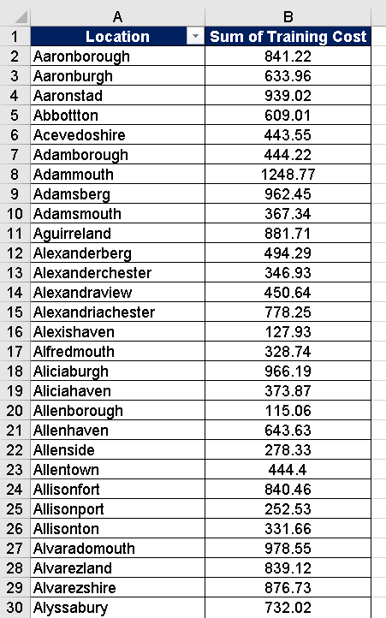
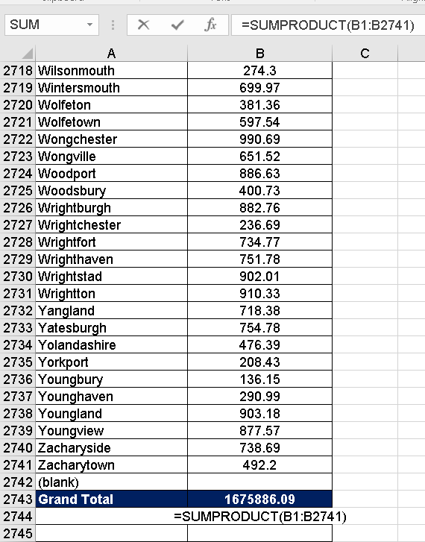
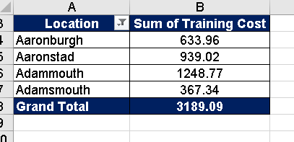
Utilize the SUMPRODUCT function to calculate the total training cost for employees in a specific location.

Slide 23
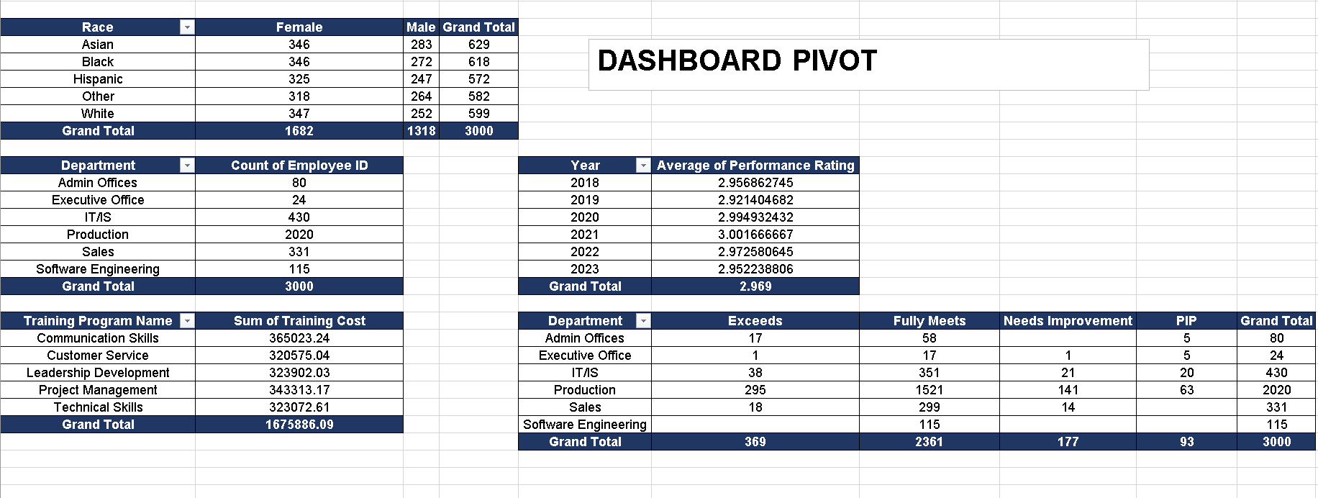
Develop a dashboard that provides an overview of key HR metrics, including headcount, performance, and training costs, using charts and pivot tables.

Slide 24
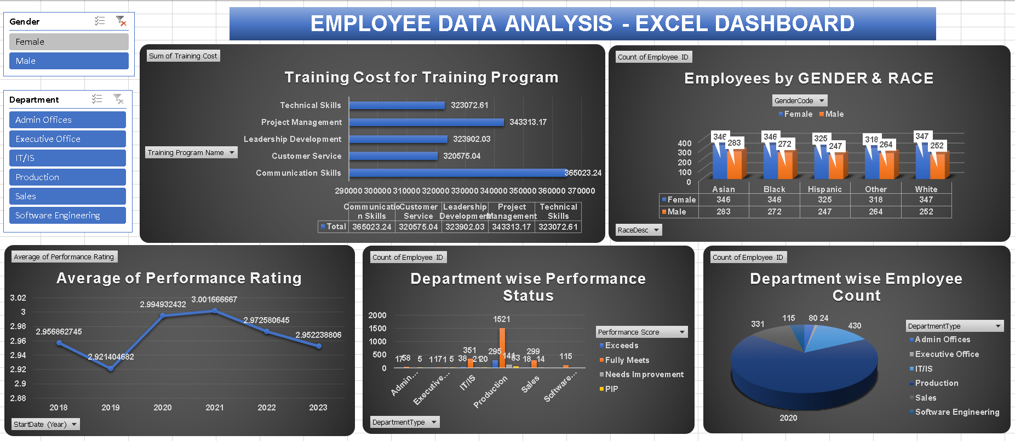
EXCEL DASHBOARD

Slide 25
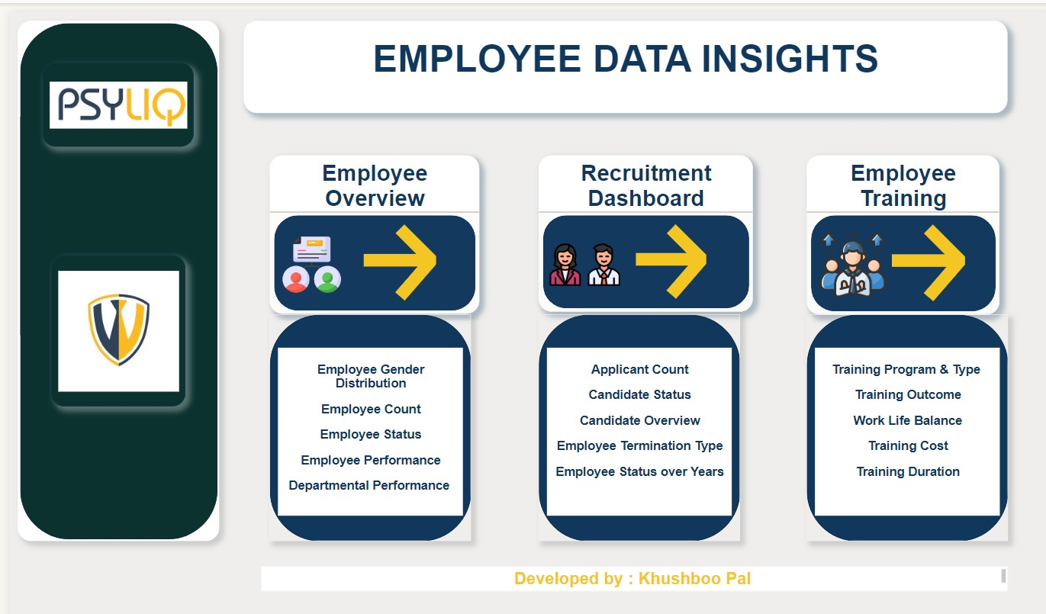
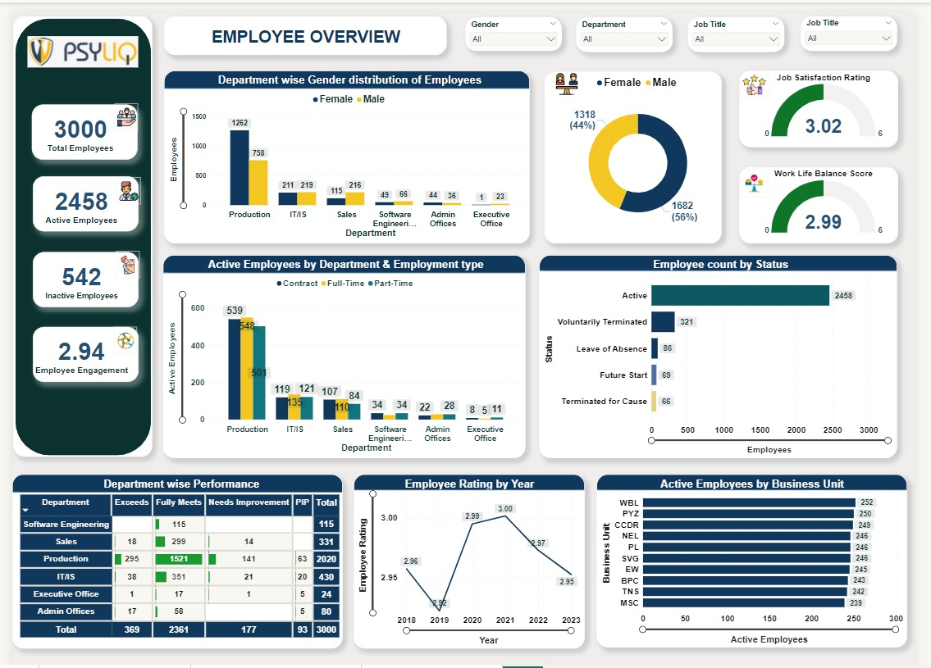
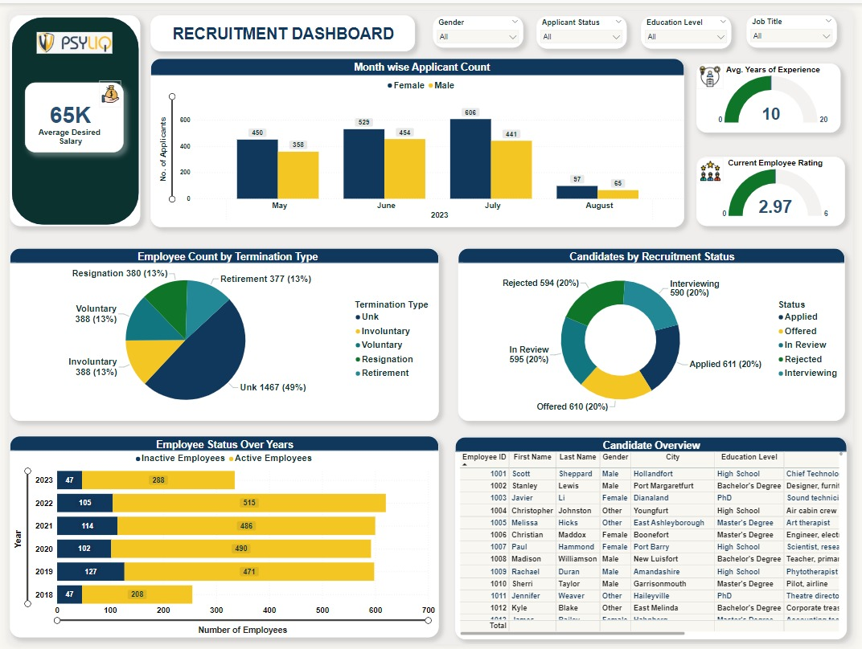
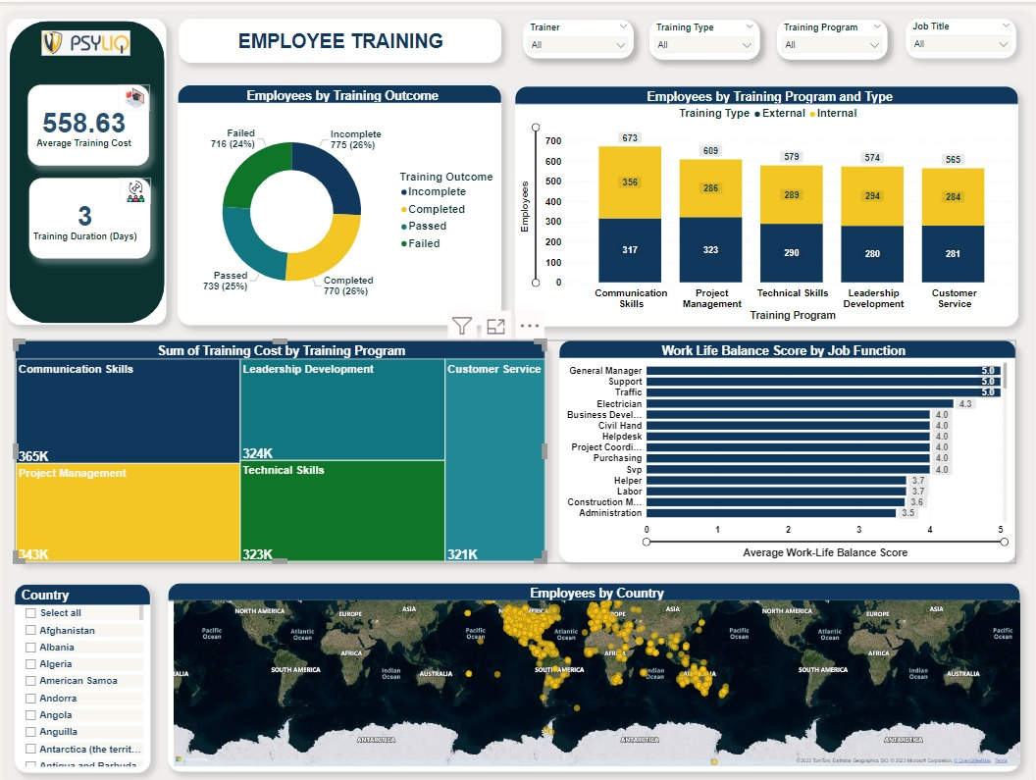
EMPLOYEE DATA ANALYSIS DASHBOARD WITH POWER BI

Slide 26



khushboopal1598@gmail.com
https://www.linkedin.com/in/khushboopalkp/

